Slide 1
Module-11: Part-4: BST – Destroy, Removal
CS 1714 – Computer Programming II

Slide 2
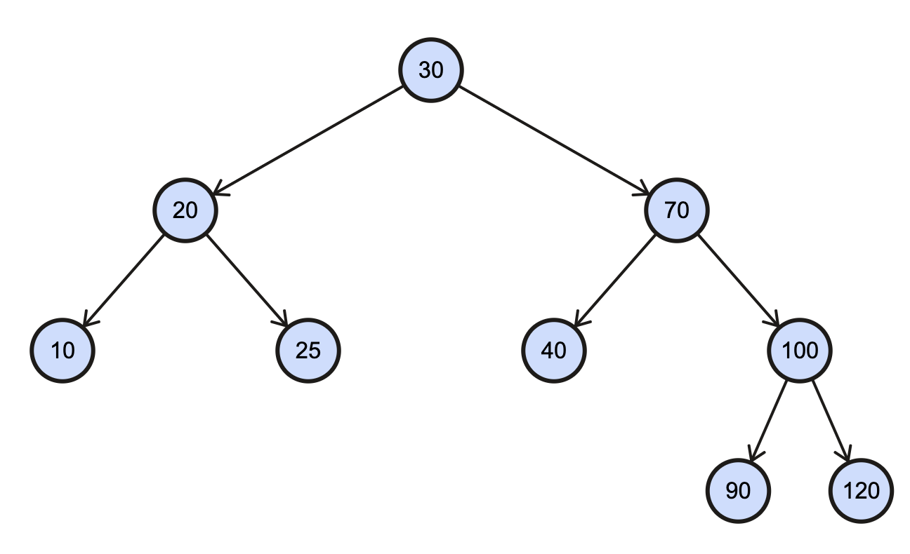
BST Destroy

Slide 3
BST Destroy
BSTNode* destroyBST(BSTNode* root)
{
if(root == NULL)
return NULL;
root->left = destroyBST(root->left);
root->right = destroyBST(root->right);
free(root);
return NULL;
}

Slide 4

BST Removal
The function recursively traverses the BST to look for the node based on some key. If it is found, it checks for one of four cases involving the node to be removed
Case 1: The node is a leaf. The node is replaced by NULL.
Case 2: The node is an internal node that has a right child and no left child. The node is replaced by the right child.
Case 3: The node is an internal node that has a left child and no right child. The node is replaced by the left child.
Case 4: The node is an internal node that has both a left and right child. This case involves finding the leftmost node in the right subtree to replace the node.
Always deallocate when removing!

Slide 5
BST Removal – Case 1 (Leaf)
Remove [90]
[90] is a leaf, so deallocate and set to NULL.

Slide 6
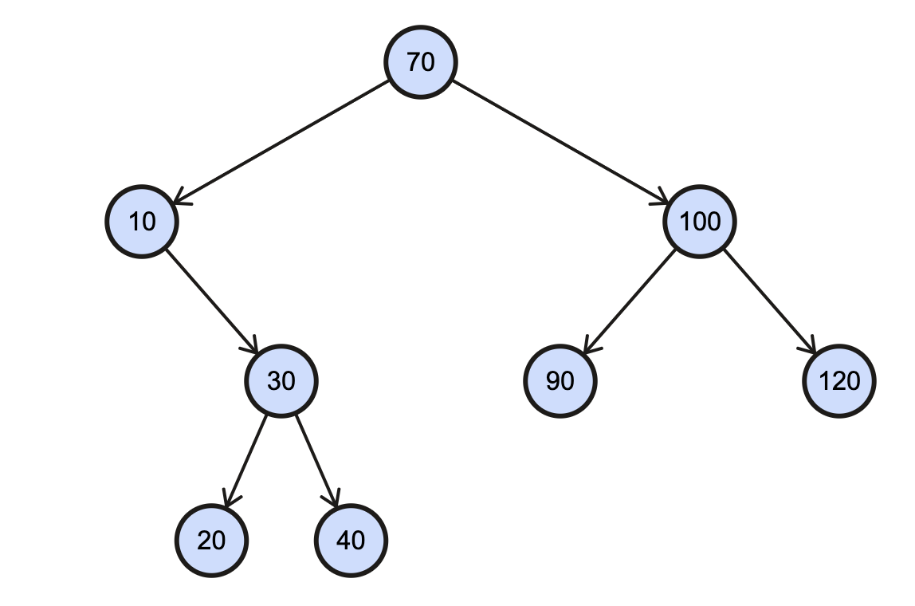
BST Removal – Case 2 (No Left Child)
Remove [10]
[10] has no left child. Deallocate [10] and its right child [30] subtree will take its place.

Slide 7
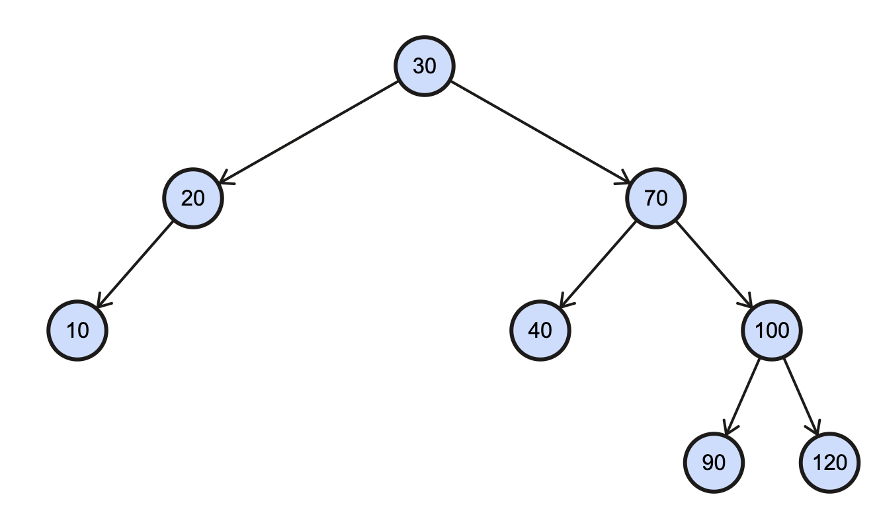
BST Removal – Case 3 (No Right Child)
Remove [20]
[20] has no right child. Deallocate [20] and its left child [10] subtree will take its place.

Slide 8
BST Removal – Case 4 (Internal Node with Both Children)
Remove [70]
[70] is an internal node. Go to the right child and then go far left as possible in that subtree. [90] replaces [70].

Slide 9
BST Removal – Find Left Most Child
BSTNode* findLeftMostChild(BSTNode* root)
{
if(root == NULL)
return NULL;
else if(root->left != NULL)
return findLeftMostChild(root->left);
return root;
}

Slide 10
BST Removal
else if(root->left == NULL || root->right == NULL)
{
BSTNode* tmp;
if(root->left == NULL)
tmp = root->right;
else
tmp = root->left;
free(root);
return tmp;
}
else
{
BSTNode* tmp = findLeftMostChild(root->right);
root->val = tmp->val;
root->right = removeNode(root->right, tmp->val);
}
}
return root;
}
BSTNode* removeNode(BSTNode* root, int v)
{
if(root == NULL)
return NULL;
if(root->val > v)
root->left = removeNode(root->left, v);
else if(root->val < v)
root->right = removeNode(root->right, v);
else
{
if(root->left == NULL && root->right == NULL)
{
free(root);
return NULL;
}

Slide 11
BST – Other Functions
Count() – returns the total number of nodes in the tree – iterative/recursive
Sum() – returns the sum of all the node values in the tree – iterative/recursive
CheckEqualTrees() – returns TRUE if two trees (or subtrees) are equal, i.e. same shape and values for all the corresponding nodes – iterative/recursive

